Slide 1
CSC301: Project Proposal
TEAM 2
Notes:
Introductions

Slide 2
Agenda
What we are trying to teach
Why we chose that area of CS
Current options available and why they may not work/ be enough

Slide 3
Data Structures
Purpose
Teach about data structures: properties and behaviours.
Motivation:
One of the topics students find most difficulties with.
Too many to learn in a short span of time.
Target user base:
University/College Students
Notes:
-purpose of our app will be to make learning data structures more interactive and fun.

Slide 4
Topics to cover
Heaps
AVL trees
Augmented trees
Graphs
If time permits:
Amortized complexity
Dynamic Arrays
Proof techniques
Mathematical induction
Loop invariants
Run time analysis
Worst case (O, Ω, Θ)
Average Case

Slide 5
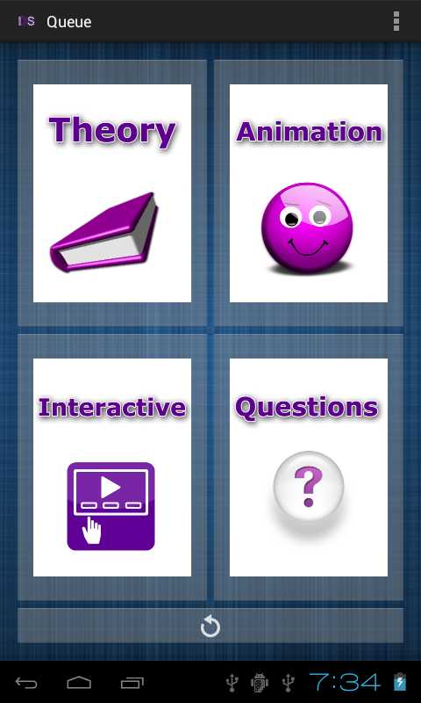
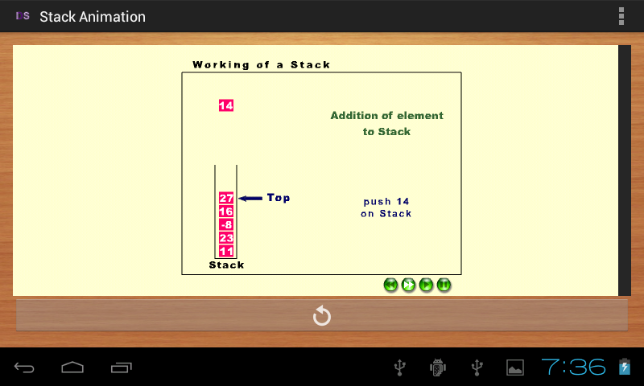
“Data Structures ”
Graphical representation of Data Structures
Achieves what we are trying to do but...
UI/UX is not the best
Topics limited to stacks and queues
Tablet UI doesn’t take advantage of extra screen real estate
Notes:
This app is called “data structures”.
very similar to what we are trying to achieve

Slide 6
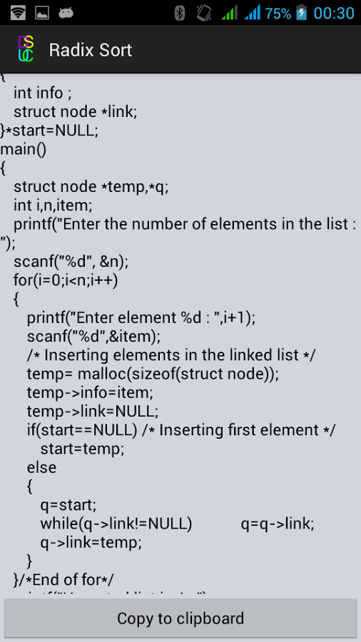
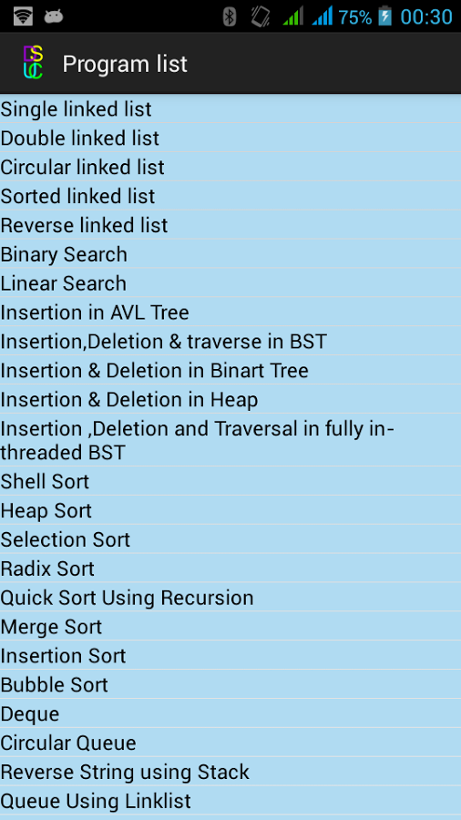
“Data Structure programs”
Covers only the learning part
Mediocre UI/UX
Large number of topics
No pseudocode; only C implementations
No graphical representation of data structures
No multiple screen support
Adware bundled

Slide 7
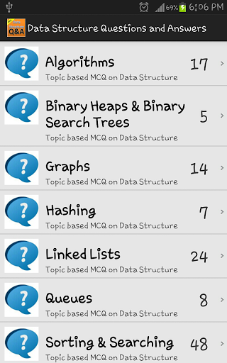
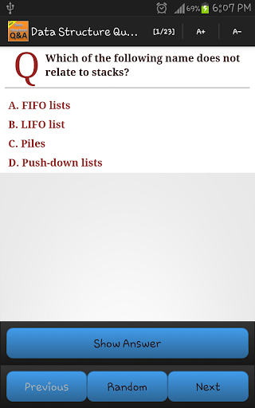
“Data Structure Questions”
Covers only the testing part
Mediocre UI/UX
Large number of test questions
Limited to only multiple-choice questions
No multiple screen support
Requires internet access

